Slide 1


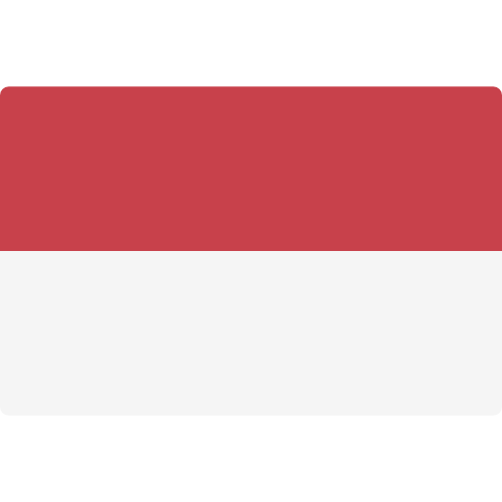



For Kids Video Content Distribution Project, we analyze key factors that lead to the conclusion on whether the selected ASEAN markets are desirable for new investment.
Kids Video Content Distribution
Challenge
Research and Benchmark work on Kids Video Content Distribution in selected 6 ASEAN Countries to identify investment opportunities.
Solution
Market Sizing and Value Chain Analysis: Assess the total market value and revenue on digital platform providers and broadcasters.
Competitive Landscape Analysis: Identify high level profiles of leading digital platform providers and broadcasters in each geographic market and analyze their key successful factors
Market Trend Analysis and Disruption Assessment: Analyze consumer and subscriber consumption trend, technology and platform adoption trends and industry’s threats, and identify rules and regulations on kids video content distribution
Deliverable
Identified market gap, opportunities and threats
Identified market with high potential suitable for new entrants
Identified the most suitable kids video content distribution platforms for each market
(Project No.: TIME-201819)
Website: www.timeconsulting.co.th

Slide 2






For Kids Video Content Distribution Project, we analyze key factors that lead to the conclusion on whether the selected ASEAN markets are desirable for new investment.
Case Study: Kids Video Content Distribution
Market Sizing and
Value Chain Analysis
Competitive Landscape Analysis
Market Trend Analysis and Disruption Assessment
KEY INSIGHTS
Total Market Value and Revenue Assessment on Digital Platform Providers and Broadcasters
Advertising Revenue
Subscription Revenue
Total Application and Video Downloads
Identify High Level Profiles of Leading Digital Platform Providers and Broadcasters in each Geographic Market
Identify the Market Leaders and Analyze their Successful Factors
Target and Research Key Digital Platform Industry Players
Consumer and Subscriber Consumption Trend Analysis
Technology Adoption Trends Analysis
Platform Adoption Trends Analysis
Industry Analysis: Threats
Rules and Regulations on Kids Video Content Distribution
Thailand
Malaysia
Indonesia
Singapore
Malaysia
Vietnam
Identified Market Gap, Opportunities and Threats
Identified Market with High Potential Suitable for New Entrants
Identified the Most Suitable Kids Video Content Distribution Platforms for Each Market
(Project No.: TIME-201819)

